Slide 1
MESSAGE ENCRYPTION AND DECRYPTION TOOL
Presented by:
Tanvir Ahmed
221002461

Slide 2
OUTLINES
Introduction
Features
System Description
Implementation
Output and Discussion
Future works
Conclusion

Slide 3
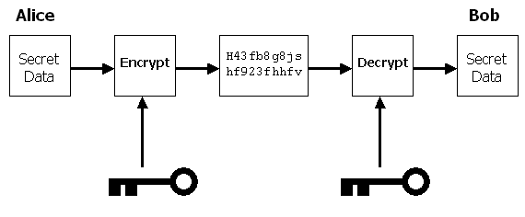
INTRODUCTION
Encryption is the process by which a readable message is converted to an unreadable form to prevent unauthorized parties from reading it.
Decryption is the process of converting an encrypted message back to its original

Slide 4
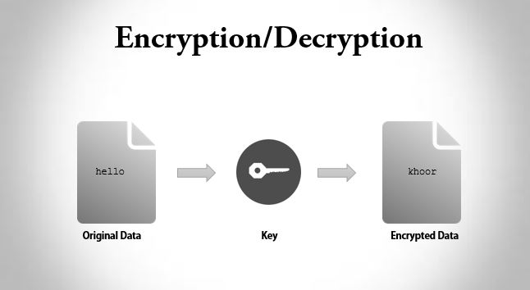
FEATURES
Encryption using a user defined key through a complex equation.
Decryption with the key that we passed with the encrypted message.

Slide 5
SYSTEM DESCRIPTION
Encrypt the message with the equation that I generated: y = (k*x + b) mod m
Here k is the key, x is the ASCII code of the character that we want to encrypt, b is a random number for more security.
Decrypt with the reverse equation: x = k^-1 (y - b) mod m
Here using the same k, y (that is the encrypted data) we can get the original message.

Slide 6
SYSTEM DESCRIPTION (cont.)
Take a message from user and ask for key.
Change the character of our string (message) to ASCII value and pass to the equation that we build with the key.
It will give us a encoded string.
Pass the key with the encoded message.
Encode the key also, so that no one can read the key.
In Decryption, extract the key from the encrypted message and decode the key.
Pass the message and key to the reverse equation and assign the decrypted characters to a string array.

Slide 7
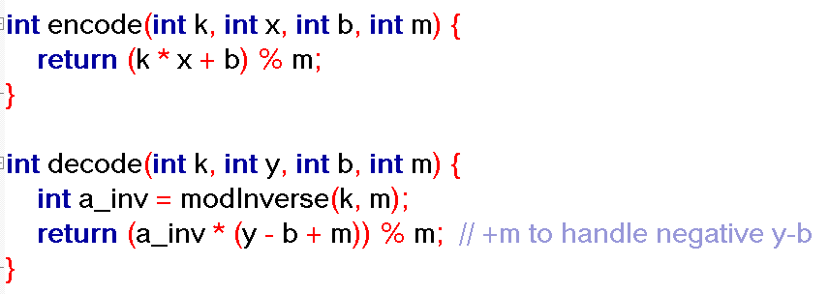
IMPLEMENTATION

Slide 8
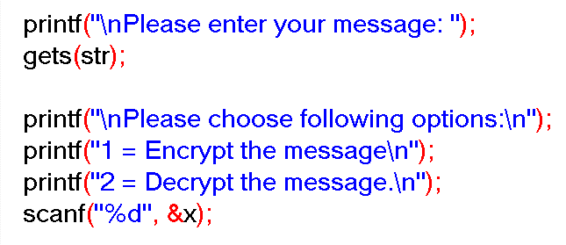
IMPLEMENTATION (cont.)

Slide 9
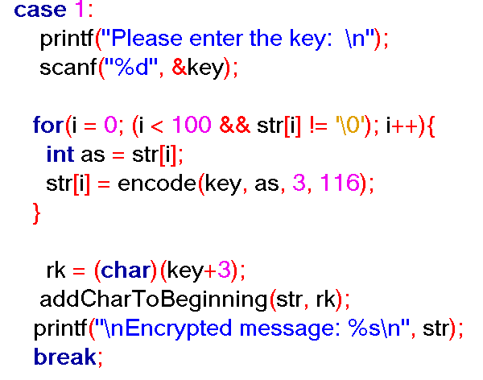
IMPLEMENTATION (cont.)

Slide 10
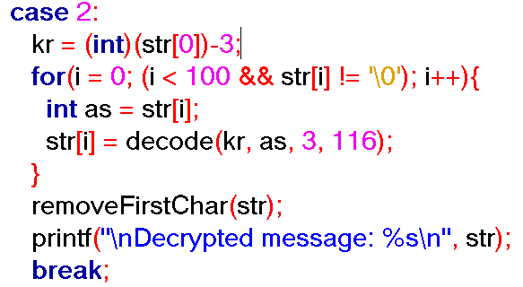
IMPLEMENTATION (cont.)

Slide 11
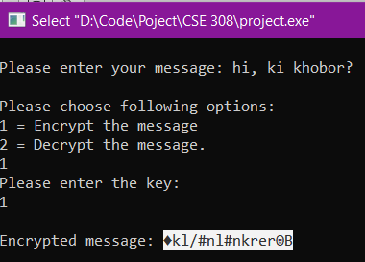
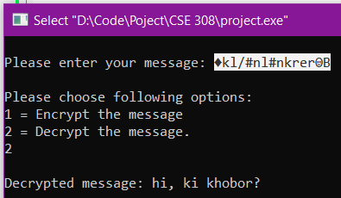
OUTPUT AND DISCUSSION
Fig1: Encryption of a message.
Fig2: Decryption of the message.

Slide 12
FUTURE WORKS
In the implementation I used two numbers on b and m variables in the equation.
Instead of passing numbers we can pick a random number from the random value picker.
Then using those value as well as passing the values with the encrypted message for the future decryption.
From this approach even I don’t know what is the value of those variables.
It ensures more security, almost impossible to crack the encrypted data.

Slide 13
CONCLUSION
My Message Encryption and Decryption Tool offers a reliable method for securing communication.
With customizable encryption message with key using an equation, users can tailor security to their specific needs.
Enhance privacy and protect sensitive information with our easy-to-use encryption solution.
Explore further possibilities and provide feedback to help us improve and expand the tool's capabilities.

Slide 14
THANK YOU

